Slide 1
ONLINE STORE
By Sharjeel & Ahzam

Slide 2
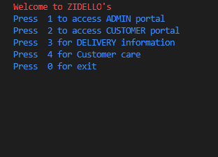
Aim/Motivation:
Primary purpose was to create a user interface in which user can access the whole store virtually online. Our project covers whole aspects and purposes an online store should have from ordering a T-shirt to stock handling.

Slide 3

Background:
Project Selection was a consensus and creating an Online store seemed to be a good and competitive idea. Basic research included ideas from Daraz Shopping Mall, Our project consist of everything that the daraz online store had

Slide 4
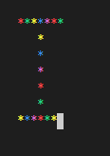
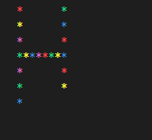
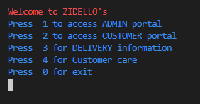
Solution Design:
Project details and features everything discussed in power point presentation.
Extra features includes real-time product id and order no assignment, checking of vague email and phone input, customer care.

Slide 5
Solution Design:
Implementation & Testing:
Project details and features everything discussed in power point presentation.
Extra features includes real-time product id and order no assignment, checking of vague email and phone input, customer care.
Customer’s and admin’s account already exist, However password is required to access the account. Admin can append the inventory as required (stock handling) whereas customer can access the inventory and add items to the card he/she wishes to order just like any online store. Customer can select delivery type, can view cart at anytime and can order item. Whereas admin can view the sales, stock and can update anything at anytime. Customer care is also present with multiple FAQ’s for customer’s assistance.

Slide 6
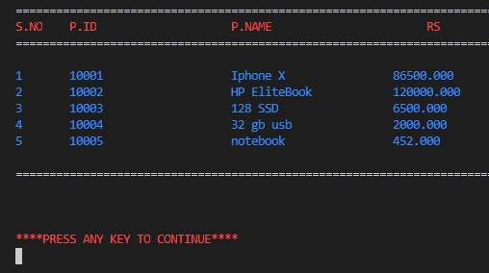
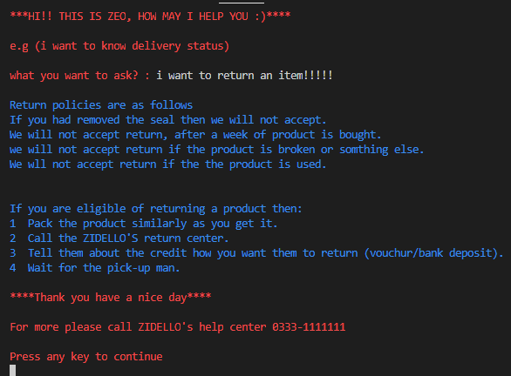
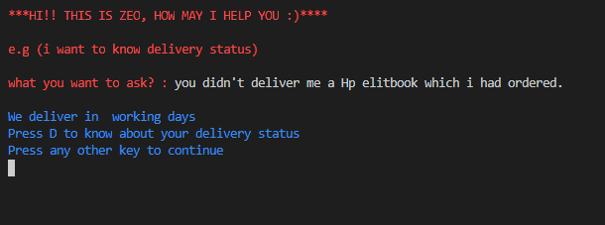
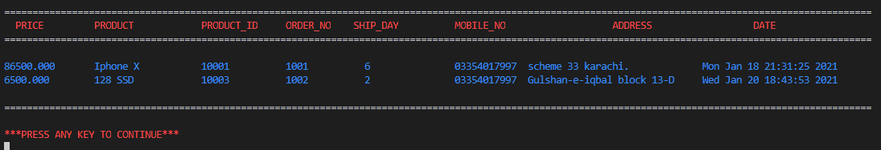
Project Breakdown Structure:
Workload was evenly distributed and an algorithm was developed tackling all the possible problems by dividing them into modules and sub modules. Then the whole project was divided and compiled together at the end for best results.

Slide 7
Results:
Conclusion:
As expected our project tackles all the major and minor components of an online store with every common feature coming in handy and easily accessible and understandable by a normal customer with suitable prompts for better accessibility.
Main role was to make a UI wherein client can get to the entire store essentially on the web. Our venture covers entire viewpoints and purposes an online store ought to have from requesting a T-shirt to stock taking care of.

